Slide 1
TechnipFMC PLC Account Deep Dive Analysis August 2025

Slide 2










Company Overview and Financial Summary
TechnipFMC is a world leader in project management, engineering and construction for the energy industry.
Company Overview
Year of Establishment
Headquarters
Employees
Revenue
(FY 2024)
R&D Spend
(FY 2024)
2017
Tyne and Wear, United Kingdom
~21,469
9083.0 USD Million
73.0 USD Million
Revenue Vs R&D Spend (FY 2020 - 2024)
Revenue share by Geography (FY 2024)
Revenue CAGR
(FY 2020 - 2024)
Financial
Snapshot
8.60%
R&D Spend CAGR
(FY 2020 - 2024)
-0.67%
Revenue in USD Million
R&D Spend in USD Million

Slide 3
Account Priorities: Construction Operations
Business Function | Account Priority | Applicable Use Cases | Workloads
Construction Operations | Development of Hybrid Flexible Pipe Technology | • Corrosion Prediction & Detection using AI in Mining Plants • Automated Concrete Monitoring • Mobile Device Field Enablement for Extraction Workers | • Construction & Commissioning • Mining Operations
 | TechnipFMC is advancing the development and commercialization of Hybrid Flexible Pipe (HFP) to address stress corrosion cracking by CO2 in flexible pipe systems. This initiative aims to standardize solutions for ultra-deep water applications, enhancing project reliability and safety. The collaboration with Petrobras is pivotal in validating HFP's performance in challenging presalt conditions, ensuring that the technology meets the rigorous demand...
Construction Operations | Integrated Execution Model Expansion for Subsea Projects | • Exploration Drill/Rig Performance Analytics • Rig Planning & Scheduling using RPA • 5G-enhanced Mining Operations | • Mining Operations • Construction & Commissioning
 | TechnipFMC is focusing on expanding its integrated execution model (iEPCI) to optimize subsea development solutions and maximize value creation, as evidenced by the new collaboration agreement with Var Energi on the Norwegian continental shelf. This approach aims to deliver greater execution certainty and operational efficiency across diverse subsea projects, including both greenfield and brownfield developments.
Construction Operations | Operational Footprint Optimization in North America | • Digital Twin for Mine Value Chain Optimization • Intelligent Compaction System • 5G-enhanced Mining Operations | • Mining Operations • Construction & Commissioning
 | The company has strategically reduced its North America footprint by 50% over the last three years through exiting unprofitable markets and product lines, as well as consolidating facilities. These actions are designed to improve operating margins and increase cash flow by doing more with less in this region.
Note: The mentioned data are not exhaustive

Slide 4
Account Priorities: Construction Operations
Business Function | Account Priority | Applicable Use Cases | Workloads
Construction Operations | Deepwater Project Development Partnership | • Rig Planning & Scheduling using RPA • Exploration Drill/Rig Performance Analytics • Real-Time Dig Assistance Systems | • Construction & Commissioning • Mining Operations
 | TechnipFMC has formed a strategic partnership with Cairn Oil & Gas to accelerate the development of subsea infrastructure for deepwater projects in India. This collaboration aims to leverage TechnipFMC's advanced technologies and integrated engineering processes to enhance project performance and efficiency.
Construction Operations | Enhancing Project Execution through Lean Principles | • AI-based Construction Project Management • Construction Progress Documentation using AR • AI-based Foremen Apps | • Construction & Commissioning • Mining Operations
 | TechnipFMC is adopting lean principles of simplification, standardization, and industrialization (SSI) to improve project execution across all functions. This approach emphasizes visual management to identify and resolve challenges early, ensuring projects remain on track and meet client expectations.
Construction Operations | Execution of iEPCI Projects | • Rig Planning & Scheduling using RPA • Exploration Drill/Rig Performance Analytics • Construction Scheduling Analysis using AI | • Construction & Commissioning • Mining Operations
 | TechnipFMC is focusing on the execution of integrated Engineering, Procurement, Construction, and Installation (iEPCI) projects, particularly in high-pressure and high-temperature subsea environments. This includes leveraging their unique technologies and extensive subsea services capabilities to enhance project delivery and client satisfaction.
Note: The mentioned data are not exhaustive

Slide 5
Account Priorities: Construction Operations
Business Function | Account Priority | Applicable Use Cases | Workloads
Construction Operations | Integrated Subsea Project Delivery for North Sea Developments | • AR/VR-based Extraction Monitoring • Construction Equipment Repair and Maintenance using AR/VR • Extended Reality for Construction Equipment Repair and Maintenance | • Construction & Commissioning • Mining Operations
 | TechnipFMC is focused on delivering integrated engineering, procurement, construction, and installation (EPCI) services for subsea projects in the North Sea, specifically targeting the Gja Nord, Cerisa, and Ofelia discoveries. Through a multi-year collaboration agreement with Vr Energi and other license partners, TechnipFMC aims to accelerate project execution timelines and enhance competitiveness by coordinating multiple subsea developments unde...
Construction Operations | Extension and Enhancement of Heidrun Offshore Infrastructure | • Extended Reality for Construction Equipment Repair and Maintenance • Exploration Drill/Rig Performance Analytics • Cloud-based Smart Construction Monitoring | • Construction & Commissioning • Mining Operations
 | TechnipFMC has secured an integrated EPCI contract for the Heidrun platform extension project awarded by Equinor, focusing on extending the production lifecycle and upgrading existing offshore infrastructure in the Norwegian North Sea. This initiative involves front-end engineering and design to support the longevity and operational efficiency of the Heidrun field, situated in deepwater conditions, thereby reinforcing TechnipFMC’s role in sustain...
Construction Operations | Expansion of Subsea Infrastructure Projects | • Exploration Drill/Rig Performance Analytics • Parametric Construction Cost Estimation using AI • Rig Planning & Scheduling using RPA | • Construction & Commissioning • Mining Operations
 | TechnipFMC is focusing on securing contracts for integrated engineering, procurement, construction, and installation (EPCI) of subsea infrastructure, particularly in deepwater projects and mature basins. The company aims to leverage its backlog of US$14.9 billion for subsea activities to enhance project execution and delivery.
Note: The mentioned data are not exhaustive

Slide 6
Account Priorities: ER&D
Business Function | Account Priority | Applicable Use Cases | Workloads
ER&D | Development of Hybrid Flexible Pipe Technology | • Pipeline Intrusion Detection System • Liquid Carryover Detection using IOT • Pipeline Equipment Blockage Detection | • Pipeline Engineering • Materials Science & Engineering • Drill Engineering
 | TechnipFMC is advancing a disruptive and scalable hybrid flexible pipe technology that offers unrivaled corrosion resistance without compromising weight or other critical attributes. This innovation addresses industry challenges such as stress corrosion cracking in high CO2 environments, particularly in pre-salt fields, and aims to reduce subsea architecture costs by impacting vessel requirements for installation.
ER&D | Advancement of All-Electric Subsea Systems | • AI-enabled Offshore Drilling Rigs Safety System • Autonomous Drilling • Drill/Rig Performance Analytics | • Hydroelectric Power & Systems • Drill Engineering • Energy Storage & Management
 | The company is pioneering all-electric subsea technology, highlighted by the award for BP's Northern Endurance CCS project, to support carbon capture and storage and other applications. Efforts include extending electric solutions to existing production systems in collaboration with clients like Petrobras, aiming to enhance performance and operational efficiency.
ER&D | Technology Innovation Focused on CO2 Management | • AI-enabled Offshore Drilling Rigs Safety System • Bio-Process Digital Twins • Fuel Extraction Process Simulation using AI | • Drill Engineering • Bio-Energy Systems & Technology • Process Engineering
 | In partnership with Petrobras, TechnipFMC developed the HISEP high-pressure separation process to capture CO2-rich dense gases directly on the seafloor. This technology exemplifies the company's commitment to solving complex subsea challenges through innovative solutions that support environmental and operational objectives.
Note: The mentioned data are not exhaustive

Slide 7
Account Priorities: ER&D
Business Function | Account Priority | Applicable Use Cases | Workloads
ER&D | Subsea 2.0 Technology Implementation | • AI-enabled Offshore Drilling Rigs Safety System • Autonomous Drilling • Digital Twin-enabled Offshore Project Design | • Drill Engineering • Advanced Manufacturing, Automation & Control Systems • Bio-Energy Systems & Technology
 | TechnipFMC is actively implementing its Subsea 2.0 technology in various projects, including the Gato do Mato development offshore Brazil. This technology is part of the company's strategy to differentiate its offerings and enhance project execution in subsea developments.
ER&D | Innovation in Offshore Solutions | • AI-enabled Offshore Drilling Rigs Safety System • Digital Twin-enabled Offshore Project Design • Drill/Rig Performance Analytics | • Drill Engineering • Advanced Manufacturing, Automation & Control Systems • Application Development & Maintenance
 | The company is focused on continuous innovation in offshore solutions, particularly through the development of integrated execution models that enhance project delivery. This includes leveraging advanced technologies to optimize performance and reduce costs across the subsea lifecycle.
ER&D | Expanding Configurable Product Architecture | • On-demand Manufacturing using 3D Printing • Autonomous Drilling • IoT-enabled Connected Compressed Air Systems | • Advanced Manufacturing, Automation & Control Systems • Drill Engineering • Manufacturing Engineering
 | The company is leveraging its Subsea 2.0 platform to increase manufacturing capacity without significant capital expenditures. This strategy allows for faster equipment delivery and improved project execution.
Note: The mentioned data are not exhaustive

Slide 8
Account Priorities: ER&D
Business Function | Account Priority | Applicable Use Cases | Workloads
ER&D | Innovating Subsea Solutions | • Energy Storage System Monitoring & Maintenance using AI • IoT-based Oil & Gas Energy Monitoring • Energy Storage System Optimization using AI | • Bio-Energy Systems & Technology • Energy Storage & Management • Hydroelectric Power & Systems
 | TechnipFMC is committed to developing innovative subsea technologies, including the industry's first all-electric system for carbon transportation and storage. This initiative aims to enhance operational efficiency and sustainability in subsea applications.
ER&D | Development of Innovative Technologies | • Robotic Valve Controller (RVC) • Automated Tube Rolling Robot • Automated Fiber Placement | • Materials Science & Engineering • Advanced Manufacturing, Automation & Control Systems • Bio-Energy Systems & Technology
 | TechnipFMC is investing in the development of innovative technologies that support subsea production systems and flexible pipe solutions. This strategic focus aims to maintain their leadership position in flexible technology and enable new frontiers in subsea exploration.
ER&D | Development and Deployment of Electric Actuation Systems for Subsea Operations | • AI-enabled Offshore Drilling Rigs Safety System • Drill/Rig Performance Analytics • Drill Performance Reporting using RPA | • Drill Engineering • Advanced Manufacturing, Automation & Control Systems • Transmission & Distribution
 | TechnipFMC is focused on advancing electric actuation technology for subsea oilfield operations, aiming to enhance performance and reliability in challenging subsea environments. The company is collaborating with Petrobras to pilot an electric actuation system scheduled for deployment on a subsea tree in 2026, with the intention to scale this technology across future oil and gas developments as part of its eSolutions portfolio.
Note: The mentioned data are not exhaustive

Slide 9
Account Priorities: Management & Strategy
Business Function | Account Priority | Applicable Use Cases | Workloads
Management & Strategy | Transformation of Commercial Models in Subsea and Surface Technologies | • AR-based Product Customization • Cloud-based Product Lifecycle Management • Digital Twins for Product Design and Development | • Corporate Strategy & Management Consulting • Product Management • Governance, Risk & Compliance
 | The company has reinvented its commercial models, developing configurable product offerings tailored to customer challenges, which underpin sustainable improvements in both Subsea and Surface Technologies. This transformation supports stronger customer relationships, improved operational workflows, and continuous performance enhancement.
Management & Strategy | Focus on Core International Markets with Long-Term Growth Potential | • Data-driven Strategic Market Expansion • Cloud-based Product Lifecycle Management • Generative AI-based Product Lifecycle Management | • Corporate Strategy & Management Consulting • Product Management • Governance, Risk & Compliance
 | TechnipFMC is concentrating on international markets that represent nearly two-thirds of Surface Technologies revenue, targeting regions with long-term production growth ambitions and strong customer relationships. This strategic focus includes emerging opportunities in regions such as Mozambique, Suriname, the Orange Basin offshore Namibia, and other frontier developments.
Management & Strategy | Pursuit of $30 Billion Subsea Inbound Goal by End of 2025 | • AI-driven Capital Investment Optimization • Data-driven Strategic Market Expansion • Blockchain-based Water Trading & Traceability | • Corporate Strategy & Management Consulting • Governance, Risk & Compliance • Leadership & Governance
 | The company is on track to achieve its three-year target of $30 billion in Subsea inbound orders by the end of 2025, supported by a diverse and differentiated order book. This milestone reflects strong direct awards and robust front-end engineering activity across multiple basins.
Note: The mentioned data are not exhaustive

Slide 10
Account Priorities: Management & Strategy
Business Function | Account Priority | Applicable Use Cases | Workloads
Management & Strategy | Strategic Collaboration for Accelerated Subsea Developments | • Data-driven Strategic Market Expansion • AI-driven Capital Investment Optimization • AI-based Government Contract Optimization | • Corporate Strategy & Management Consulting • Governance, Risk & Compliance • Leadership & Governance
 | TechnipFMC’s strategic intent includes fostering long-term partnerships with key oil and gas operators such as Vr Energi to enable faster and more competitive subsea project developments in the North Sea region. The company’s approach emphasizes integrated commercial models and coordinated execution across multiple license areas to optimize resource utilization and project delivery outcomes.
Management & Strategy | Sustainability Advancement through Renewable Energy Integration | • AI-based Sustainable Energy Transition • IoT-Based Carbon Emissions Monitoring • Predictive Analytics for Carbon Emission | • Corporate Social Responsibility • Corporate Strategy & Management Consulting • Governance, Risk & Compliance
 | TechnipFMC is advancing its sustainability agenda by integrating renewable energy solutions within its operational footprint, exemplified by the commissioning of a rooftop solar photovoltaic system at its Johor Bahru facility in Malaysia. This initiative, executed in partnership with TotalEnergies ENEOS, supports TechnipFMC’s goal to reduce carbon footprint and enhance energy efficiency through long-term power purchase agreements and decentralize...
Management & Strategy | Strategic Partnership for Subsea Technology Advancement | • Data-driven Strategic Market Expansion • AI-based Sustainable Energy Transition • Blockchain-based Stakeholder Revenue Sharing | • Corporate Strategy & Management Consulting • Governance, Risk & Compliance • Corporate Social Responsibility
 | TechnipFMC is pursuing collaborative partnerships, exemplified by its agreement with Petrobras, to jointly develop and validate innovative subsea technologies. This strategic alliance supports TechnipFMC’s broader goal of accelerating subsea electrification and positioning the company as a leader in next-generation subsea solutions.
Note: The mentioned data are not exhaustive

Slide 11
Account Priorities: Management & Strategy
Business Function | Account Priority | Applicable Use Cases | Workloads
Management & Strategy | Strategic Growth in Deepwater Hydrocarbon Basins | • Data-driven Strategic Market Expansion • AI-driven Capital Investment Optimization • Intelligent Face-off Prediction | • Corporate Strategy & Management Consulting • Leadership & Governance • Governance, Risk & Compliance
 | TechnipFMC anticipates strong growth in its subsea operations driven by key deepwater hydrocarbon basins and new exploration frontiers. The company is strategically positioning itself to capitalize on these opportunities over the next 24 months.
Management & Strategy | Driving Corporate Strategy and Governance | • Data-driven Strategic Market Expansion • AI-driven Capital Investment Optimization • Cloud-based Risk Management | • Corporate Strategy & Management Consulting • Leadership & Governance • Governance, Risk & Compliance
 | TechnipFMC focuses on developing corporate strategies that align with long-term business goals and sustainability. This includes project management, risk management, and ensuring compliance with ethical standards.
Management & Strategy | Strategic Oversight of Subsea Initiatives | • Task Delegation Automation using AI • Data-driven Strategic Market Expansion • AI-based Project Management | • Leadership & Governance • Project/Programs Management • Corporate Strategy & Management Consulting
 | Provide leadership and strategic direction for subsea projects, ensuring alignment with corporate goals. Monitor project performance and resource allocation to drive successful outcomes in the HISEP pilot project.
Note: The mentioned data are not exhaustive

Slide 12
Account Priorities: Manufacturing & Production
Business Function | Account Priority | Applicable Use Cases | Workloads
Manufacturing & Production | Quality Control and Production Efficiency | • AI-based Quality Control in Manufacturing • Automated Production Line Optimization • IoT-based Manufacturing Quality Control | • Quality Control • Production • Production Control
 | The focus on maintaining high-quality standards in manufacturing processes is critical for TechnipFMC's operational success. This includes optimizing production lines and ensuring adherence to quality control measures to meet client expectations.
Manufacturing & Production | Deployment of Solar Photovoltaic Systems to Support Factory Energy Needs | • Cloud-based Production Monitoring • Production Report Automation • 5G-enabled Manufacturing Unit | • Production Planning • Production • Production Control
 | TechnipFMC has implemented a 680-kilowatt rooftop solar photovoltaic installation at its Johor Bahru manufacturing site, designed to supply approximately 20% of the plant’s energy requirements. This production-side investment demonstrates the company’s commitment to incorporating renewable energy sources into its manufacturing operations, contributing to operational sustainability and energy cost management.
Manufacturing & Production | Operational Launch of Advanced Manufacturing Facility | • 5G-enabled Manufacturing Unit • Cloud-based Manufacturing Operations • Virtual Tour of Manufacturing Facility | • Production • Plant Maintenance • Production Planning
 | The operational commencement of the new manufacturing facility in Hyderabad marks a significant investment in advanced infrastructure. This facility is designed to meet high standards of quality and functionality, supporting the production of specialized equipment for the energy sector.
Note: The mentioned data are not exhaustive

Slide 13
Account Priorities: Manufacturing & Production
Business Function | Account Priority | Applicable Use Cases | Workloads
Manufacturing & Production | Quality Assurance in Pipeline Fabrication | • Automated Visual Inspection • AI-powered Quality Control Apps • 3D Scanning for Quality Control | • Quality Control • Production Control • Production
 | TechnipFMC has established a frame agreement with Axess Group for inspection services related to pipeline fabrication in Norway. This agreement focuses on ensuring quality control and regulatory compliance, reinforcing TechnipFMC's commitment to safety and operational excellence.
Manufacturing & Production | Optimizing Production Processes and Quality Control | • Automated Production Line Optimization • AI-based Production Planning and Control • Production Planning and Control using Machine Learning | • Production Planning • Production Control • Production
 | The organization emphasizes efficient production planning and quality assurance to meet manufacturing targets. This includes maintaining equipment, managing production lines, and ensuring adherence to quality standards.
Manufacturing & Production | Quality Control in Subsea Equipment Production | • 3D Scanning for Quality Control • Analytics for Real-time Product Quality Prediction • IoT-based Manufacturing Quality Control | • Quality Control • Production • Production Control
 | Ensure adherence to quality standards in the manufacturing of subsea equipment, including the Tracerco Profiler. Implement efficient production processes to meet project timelines and specifications.
Note: The mentioned data are not exhaustive

Slide 14
Account Priorities: Customer Support & Service, Manufacturing & Production
Business Function | Account Priority | Applicable Use Cases | Workloads
Manufacturing & Production | Efficient Manufacturing of Subsea Umbilicals and Flowlines | • Automated Production Line Optimization • AI-based Oil and Gas Production Optimization • 3D Printed Thimble Plugging Device | • Production • Production Planning • Production Control
 | The organization is prioritizing the design, manufacture, and installation of subsea umbilicals, risers, and flowlines as part of the Kaskida project. This initiative aims to optimize production processes and ensure high-quality standards in manufacturing operations.
Customer Support & Service | Enhanced Well Intervention Services | • Field Service Technician Enablement • AI-based Field Service Management • Data-driven Customer Support Optimization | • Customer Success • Product Installation, Maintenance & Technical Support • Customer Service & Support
 | The introduction of riserless coiled tubing as part of TechnipFMC's well intervention offerings represents a significant enhancement in customer service. Developed in partnership with Halliburton, this innovative solution aims to reduce cycle times and lower the overall cost of life of field services, providing measurable value to clients.
Customer Support & Service | Strengthening Customer Relationships | • Data-driven Customer Support Optimization • Real-time Customer Support Monitoring • Real-time Customer Support Analytics | • Customer Success • Customer Service & Support • Product Installation, Maintenance & Technical Support
 | The organization is focused on building strong customer relationships through proactive support and effective communication. This includes addressing inquiries and issues promptly, ensuring customer satisfaction, and fostering long-term loyalty.
Note: The mentioned data are not exhaustive

Slide 15
Account Priorities: Customer Support & Service
Business Function | Account Priority | Applicable Use Cases | Workloads
Customer Support & Service | Enhancing Customer Engagement and Satisfaction | • 5G-enabled Customer Support System • Data-driven Customer Support Optimization • Real-time Customer Support Monitoring | • Customer Success • Customer Service & Support • Product Installation, Maintenance & Technical Support
 | The company is committed to building strong relationships with clients through proactive support and effective communication. This includes addressing inquiries, troubleshooting issues, and providing ongoing technical assistance to ensure customer satisfaction.
Customer Support & Service | Enhanced Technical Support for Subsea Solutions | • Field Service Technician Enablement • Real-time Customer Support Monitoring • Data-driven Customer Support Optimization | • Product Installation, Maintenance & Technical Support • Customer Service & Support • Customer Success
 | Provide comprehensive technical support for the Tracerco Profiler instrument used in subsea applications. Ensure timely assistance and troubleshooting to enhance customer satisfaction and operational efficiency.
Customer Support & Service | Enhanced Technical Support for Subsea Systems | • Field Service Technician Enablement • 5G-enabled Customer Support System • AI-based Field Service Management | • Product Installation, Maintenance & Technical Support • Customer Service & Support • Customer Success
 | TechnipFMC is focused on providing comprehensive technical support for its subsea systems, ensuring clients receive timely assistance throughout the lifecycle of their projects. This includes installation support and life-of-field services to maintain operational efficiency and client satisfaction.
Note: The mentioned data are not exhaustive

Slide 16
Account Priorities: Finance & Accounting
Business Function | Account Priority | Applicable Use Cases | Workloads
Finance & Accounting | Maximizing Free Cash Flow and Shareholder Returns | • Cash Flow Forecasting using RPA • AI-powered Cashflow Management Platform • ML-based Cashflow Prediction | • Financial Planning & Analysis • Treasury & Risk • Accounts Receivable
 | TechnipFMC has demonstrated a commitment to returning a significant portion of free cash flow to shareholders, distributing 85% of free cash flow in the first half of 2025 through dividends and share buybacks. The company targets distributing at least 70% of free cash flow annually, supported by a strong balance sheet and disciplined capital management.
Finance & Accounting | Debt Reduction and Balance Sheet Strengthening | • AI-powered Cashflow Management Platform • Cash Flow Forecasting using RPA • Treasury Workflow Automation | • Treasury & Risk • Accounts Payable • Fixed Asset Management
 | The company actively manages its debt profile, exemplified by the repayment of EUR 200 million private placement notes in June 2025, reducing gross debt to $696 million. Maintaining a strong cash position with $950 million in cash and equivalents supports financial flexibility and operational resilience.
Finance & Accounting | Improved Operational Profitability Driving EBITDA Growth | • Virtual Assistant for Financial Operation • Financial Forecasting using Digital Twin • Predictive Analytics based Revenue Cycle Management | • Financial Planning & Analysis • Accounts Payable • Fixed Asset Management
 | TechnipFMC has increased its full-year adjusted EBITDA guidance to $1.8 billion for 2025, reflecting a 30% increase over the prior year, driven by strong backlog and execution. This improvement is supported by enhanced margins in both Subsea and Surface Technologies segments.
Note: The mentioned data are not exhaustive

Slide 17
Account Priorities: Finance & Accounting, Sales & Marketing
Business Function | Account Priority | Applicable Use Cases | Workloads
Finance & Accounting | Strategic Financial Planning and Compliance | • AI-based Financial Compliance Management • Analytics-based Financial Performance Optimization • AI-based Financial Planning and Analysis | • Financial Regulatory Reporting & Compliance • Financial Planning & Analysis • Treasury & Risk
 | The organization prioritizes accurate financial reporting and regulatory compliance to support informed decision-making. This includes managing financial risks and ensuring sustainable growth through effective financial strategies.
Finance & Accounting | Financial Planning for Strategic Projects | • Cloud-based Financial Planning and Analysis • AI-based Financial Planning and Analysis • Analytics-based Financial Performance Optimization | • Financial Planning & Analysis • Treasury & Risk • Tax
 | Implement robust financial planning and analysis to support the funding and execution of key projects like the HISEP pilot. Ensure compliance with financial regulations while optimizing resource allocation for maximum project impact.
Sales & Marketing | Strengthening Customer Relationships through Direct Awards and Collaboration | • AI-powered Sales Enablement • Sales Conversation Analytics • Virtual Assistants for Sales Representatives | • Sales Enablement & Support • Business Development • Account Management
 | TechnipFMC emphasizes building and enhancing strong customer relationships, as demonstrated by a high level of direct awards and strategic collaborations such as the iEPCI agreement with Var Energi. This approach enables the company to tailor solutions to customer needs and secure a diverse set of project awards.
Note: The mentioned data are not exhaustive

Slide 18
Account Priorities: Sales & Marketing
Business Function | Account Priority | Applicable Use Cases | Workloads
Sales & Marketing | Targeted Market Penetration in Emerging Offshore Regions | • Sales Conversation Analytics • Real-Time Sales and Service • AI-powered Sales Enablement | • Business Development • Field & Channel Sales • Sales Enablement & Support
 | The company is actively pursuing new contracts and project opportunities in emerging offshore markets including Suriname, Mozambique, Guyana, and the Eastern Mediterranean. Recent awards, such as the iEPCI contract from TotalEnergies in Suriname, highlight TechnipFMC's commitment to expanding its presence in these high-potential regions.
Sales & Marketing | Securing EPCI Contracts for Major Projects | • Real-Time Sales and Service • Sales Quote Automation • AI-powered Sales Enablement | • Business Development • Field & Channel Sales • Sales Enablement & Support
 | In Q1 2025, TechnipFMC secured US$2.8 billion in orders, including significant EPCI contracts from major clients like Shell and Equinor. These contracts are pivotal for expanding TechnipFMC's market presence and driving revenue growth in subsea operations.
Sales & Marketing | Driving Revenue Growth through Strategic Marketing | • AI-driven Sales Targeting • Cloud-based Sales Targeting and Campaign Personalization • AI-powered Campaign Optimization | • Sales Strategy & Planning • Marketing Strategy & Brand Management • Field & Channel Sales
 | The sales and marketing function is focused on executing strategies that promote brand awareness and drive revenue. This includes market research, sales enablement, and developing effective communication with stakeholders.
Note: The mentioned data are not exhaustive

Slide 19
Account Priorities: Sales & Marketing, Supply Chain
Business Function | Account Priority | Applicable Use Cases | Workloads
Sales & Marketing | Market Development for Subsea Technologies | • AI-driven Sales Targeting • Cloud-based Sales Targeting and Campaign Personalization • Data-driven Brand Positioning | • Business Development • Marketing Strategy & Brand Management • Sales Strategy & Planning
 | Develop marketing strategies to promote TechnipFMC's subsea solutions and technologies to potential clients. Focus on building strong relationships with stakeholders in the oil and gas sector to drive sales growth.
Supply Chain | Optimizing Operational Workflows to Support Project Execution | • Data-driven Supply Chain Optimization • AI-enabled Port Optimization • AI-driven Supply Chain Optimization | • Fulfilment Management • Supply Chain Analytics • Logistics & Distribution
 | TechnipFMC is focused on optimizing operational workflows across its business to drive continuous improvement in project execution efficiency and delivery certainty. These efforts support the company's ability to manage a substantial backlog and meet increasing demand in subsea and surface technologies.
Supply Chain | Enhancing Supply Chain Efficiency and Risk Management | • Data-driven Supply Chain Optimization • Analytics-based Supply Chain Cost Optimization • Predictive Analytics-based Supply Chain Management | • Supply Chain Analytics • Supply Chain Risk & Compliance • Fulfilment Management
 | TechnipFMC is dedicated to optimizing logistics, inventory control, and order fulfillment to ensure efficient operations. This initiative includes utilizing analytics for data-driven decisions and mitigating risks within the supply chain.
Note: The mentioned data are not exhaustive

Slide 20
Account Priorities: Supply Chain, Human Resources
Business Function | Account Priority | Applicable Use Cases | Workloads
Supply Chain | Logistics Optimization for Project Delivery | • Predictive Analytics-based Logistics Optimization • Data-driven Logistics Optimization • RFID-based Logistics Optimization | • Logistics & Distribution • Fulfilment Management • Inventory Management
 | Enhance logistics and supply chain management to ensure timely delivery of materials and equipment for the HISEP project. Implement strategies to minimize costs while maintaining efficiency in the supply chain.
Supply Chain | Optimized Logistics for Subsea Projects | • Predictive Analytics-based Logistics Optimization • Data-driven Logistics Optimization • AI-driven Supply Chain Optimization | • Logistics & Distribution • Fulfilment Management • Supply Chain Analytics
 | The company is prioritizing the optimization of logistics and supply chain operations to support its subsea projects effectively. This includes ensuring timely delivery of materials and equipment to meet project deadlines and enhance operational efficiency.
Human Resources | Workforce Engagement and Development | • Employee Engagement App • AI-powered Employee Engagement • AI-powered Employee Retention | • Employee Relation, Engagement & Retention • Learning & Development • HR Strategy & Governance
 | The organization is prioritizing employee engagement and development initiatives to foster a positive work environment. This includes strategies aimed at talent acquisition, retention, and enhancing overall employee satisfaction.
Note: The mentioned data are not exhaustive

Slide 21
Account Priorities: IT, Human Resources
Business Function | Account Priority | Applicable Use Cases | Workloads
Human Resources | Fostering a Positive Work Environment | • Employee Engagement App • Cloud-based HR Management • AI-powered Employee Retention | • Employee Relation, Engagement & Retention • HR Strategy & Governance • HRIS & Analytics
 | TechnipFMC is dedicated to aligning HR practices with organizational objectives to enhance employee performance and satisfaction. This includes talent acquisition, employee engagement initiatives, and compliance with labor laws.
Human Resources | Talent Acquisition for Project Support | • AI based Talent Acquisition • Cloud-based Talent Acquisition • Cloud-based Talent Management | • Talent Acquisition • Employee Relation, Engagement & Retention • Learning & Development
 | Focus on recruiting skilled personnel to support the Petrobras Mero 3 project, including roles created in the Tees Valley region. Enhance workforce capabilities to meet project demands and ensure successful project delivery.
IT | Digital Transformation Initiatives | • Data-driven Customer Support Optimization • Data-driven Customer Insights Platform • AI-powered Sales Enablement | • IT Consulting • Artificial Intelligence & Data Science • Legacy Modernization
 | TechnipFMC is investing in digital transformation initiatives to enhance operational efficiency and data-driven decision-making. This includes the development of custom software solutions and the integration of advanced analytics to support business operations.
Note: The mentioned data are not exhaustive

Slide 22
Account Priorities: IT, Legal
Business Function | Account Priority | Applicable Use Cases | Workloads
IT | Developing Secure and Efficient Digital Solutions | • Connected Device Security • Network Planning and Design using Digital Twins • Cloud Security Automation | • IT Consulting • Cybersecurity • Infrastructure Management System
 | The IT function focuses on creating and managing digital infrastructure that enhances operational efficiency and data security. This includes application development, cybersecurity measures, and the integration of advanced technologies to support business needs.
IT | Digital Solutions for Operational Efficiency | • AI-based Oil and Gas Production Optimization • Big Data Analytics for Shipbuilding Operations • AI-enabled Port Optimization | • Artificial Intelligence & Data Science • Application Development & Maintenance • Data Engineering
 | Develop and implement digital solutions that enhance operational efficiency in project execution and management. Focus on data analytics and system integration to support decision-making processes in subsea operations.
Legal | Compliance and Risk Management | • AI-based Legal Risk Management • Cloud-based Legal Risk Management • Big Data-based Legal Risk Management | • Legal Governance & Compliance • Contract Management & Transaction • Intellectual Property Rights
 | The legal function is focused on ensuring compliance with regulatory standards and managing legal risks associated with business operations. This includes contract management and intellectual property protection to safeguard the organization's interests.
Note: The mentioned data are not exhaustive

Slide 23
Account Priorities: Procurement, Legal
Business Function | Account Priority | Applicable Use Cases | Workloads
Legal | Ensuring Compliance and Risk Mitigation | • AI-based Legal Risk Management • Cloud-based Legal Risk Management • Big Data-based Legal Risk Management | • Legal Governance & Compliance • Contract Management & Transaction • Intellectual Property Rights
 | The legal function is committed to managing contracts, protecting intellectual property, and ensuring adherence to regulations. This initiative aims to safeguard the organization’s interests while mitigating legal risks.
Legal | Contract Management for Strategic Partnerships | • RPA-based Contract Management • Automated Contract Management • RPA-based Document Transaction Management | • Contract Management & Transaction • Legal Governance & Compliance • Litigation
 | Manage and oversee contracts related to the Petrobras Mero 3 project to ensure compliance and mitigate legal risks. Focus on protecting intellectual property rights associated with innovative technologies developed for subsea applications.
Procurement | Supplier Relationship Management | • AI-based Supplier Relationship Management • AI-based Supplier Relationship Optimization • Cloud-based Supplier Relationship Management | • Strategic Sourcing & Purchasing • Vendor Management
 | TechnipFMC is prioritizing the management of supplier relationships to ensure quality and compliance in procurement processes. This includes evaluating and negotiating with suppliers to secure cost-effective sourcing opportunities.
Note: The mentioned data are not exhaustive

Slide 24
Account Priorities: Procurement
Business Function | Account Priority | Applicable Use Cases | Workloads
Procurement | Strategic Sourcing and Supplier Management | • AI-based Supplier Relationship Optimization • Predictive Cost Analytics for Sourcing • AI-based Supplier Relationship Management | • Strategic Sourcing & Purchasing • Vendor Management
 | TechnipFMC aims to identify cost-effective sourcing opportunities and manage vendor relationships for quality compliance. This initiative focuses on optimizing procurement processes to ensure timely delivery and strong supplier partnerships.
Procurement | Strategic Sourcing for Subsea Projects | • Sustainable Sourcing Platform • Predictive Cost Analytics for Sourcing • Blockchain-based Sustainable Sourcing | • Strategic Sourcing & Purchasing • Vendor Management
 | Identify and negotiate with suppliers for critical components and services required for the Petrobras Mero 3 project. Focus on securing cost-effective sourcing opportunities while maintaining quality and compliance.
Note: The mentioned data are not exhaustive

Slide 25
Estimated IT Spend
Estimated Total IT Spend (in USD Million)
Last 3 Financial Years CAGR: 16.44%
Note: The IT spend is calculated using Draup Proprietary Model, which utilizes publicly available datasets for Digital Intentions, Use cases, Outsourcing partnership datasets, Company's Financial Reports, Official Public commentaries along with Draup Profile Database and Draup's Salary estimation ML model to arrive at the estimates for the expense in each spend category by the company

Slide 26











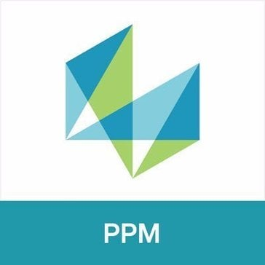
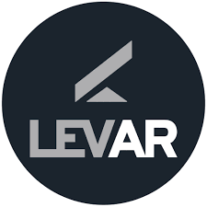


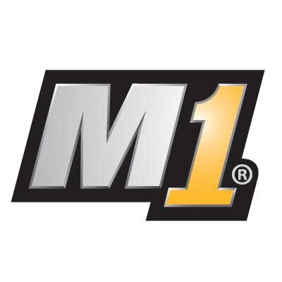






Technology Stack
Analytics & Business Intelligence
Artificial Intelligence & Machine Learning
MINITAB
Workscope
Microsoft Power BI
SAP BusinessObjects Business Intelligence (BI)
ChatBot
Matlab
Scikit-Learn
PyTorch
Asset Management Software
Augmented Reality & Virtual Reality
IndySoft
Infor EAM
IBM Maximo
SmartPlant Foundation
Levar
A-Frame
Forge
Automotive Software
Big Data Software
Manager SE
Azure Cosmos DB
Microsoft Access
Apache Hadoop
Apache Spark for Azure HDInsight
Blockchain Software
Cloud Software
BlockFi
AWS
ServiceNow Now Platform
Microsoft Azure
AWS lambda
Note: The tools listed above are not exhaustive.

Slide 27


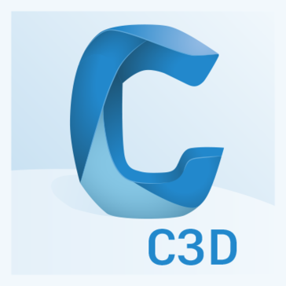









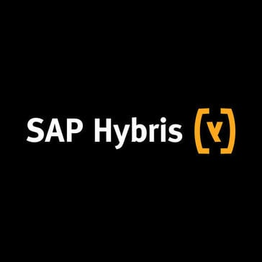









Technology Stack
Communications & Media Software
Computer-Aided Engineering, Design & Manufacturing
Authory
AutoPIPE
Civil 3D
AutoCAD
STAAD.Pro
Computing Devices
Construction Software
alcatel Phone
Bluebeam Revu
Constru
C-SITE
Content Management Software
Customer Service Software
Isso
Methode
Monitoro
Qualtrics
SAP Hybris Service
ServiceMax
Database Software
Data Management Software
GraphQL
Oracle Database
Amazon DynamoDB
CouchDB
Azure Site Recovery
Commvault Cloud
Microsoft Power Query
Pentaho
Note: The tools listed above are not exhaustive.

Slide 28
























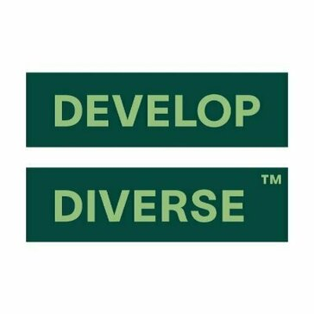
Technology Stack
Design Software
DevOps Software
Adobe Illustrator
Figma
Microsoft Visio
Pinterest
Azure Pipelines
Gradle
Grafana
SpecFlow
E-Commerce Software
Education Software
Accesso
Fera
Downstream
Elevar
General Assembly
Mastera
Enterprise Resource Planning Software
Environment, Health & Safety Management Software
SAP S/4HANA
Citect
Global Shop Solutions ERP
NetSuite
Intelex
SAP Quality Management
Finance & Accounting Software
Generative AI Software
CashFlows
CSC Corptax
Kyriba
hCentive
Develop Diverse
Note: The tools listed above are not exhaustive.

Slide 29








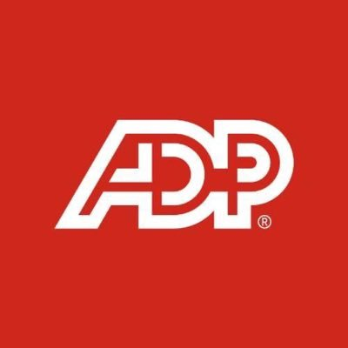







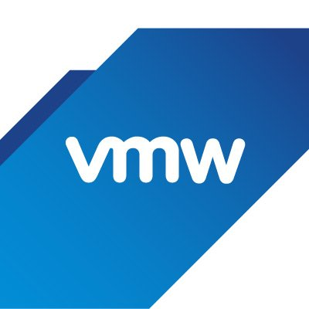


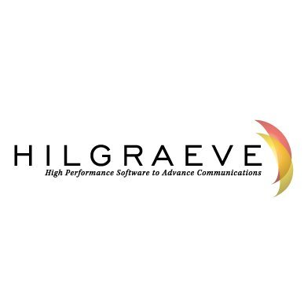
Technology Stack
Geographic Information System Software
Governance, Risk & Compliance Software
Manifold System
QGIS
Assurance
Digital iD
Source Intelligence
Workiva
Health Care Software
Hosting Providers
Eplan
Falck
Amazon CloudFront
Human Capital Management Software
IoT Software
ADP Payroll
Articulate 360
Contractor Compliance
Fluida
MachineShop
Parsable
IT Infrastructure Software
IT Management Software
Amazon EC2
Amazon S3
Citrix XenApp
Horizon 7
AirWatch
Amazon CloudWatch
Global IDs Data Ecosystem Suite
HyperACCESS
Note: The tools listed above are not exhaustive.

Slide 30
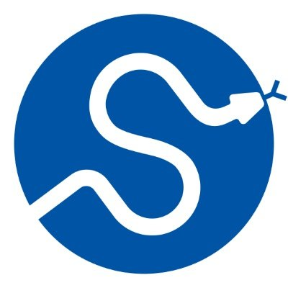








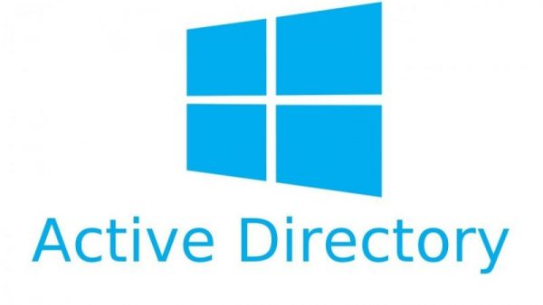


Technology Stack
Laboratory Software
Manufacturing Execution System
SciPy
SAP Digital Manufacturing Cloud
SAP Manufacturing Execution
Manufacturing Intelligence Software
Marine Software
CAESAR II
SAP Manufacturing Integration and Intelligence
Orcaflex
Marketing Software
Networking Hardware
Adly
Databook
Feedback Loop
GWI
Cisco Router
Nonprofit Software
Office Administration Software
iVolunteer
Active Directory
Gmail
Microsoft Excel
Microsoft PowerPoint
Note: The tools listed above are not exhaustive.

Slide 31

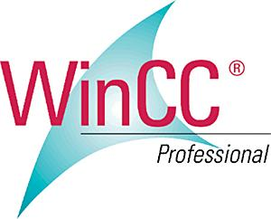













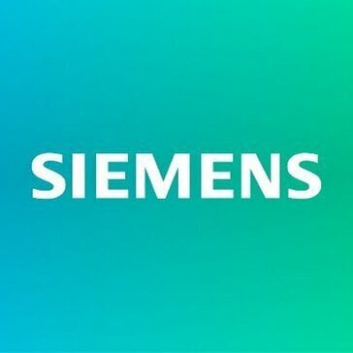






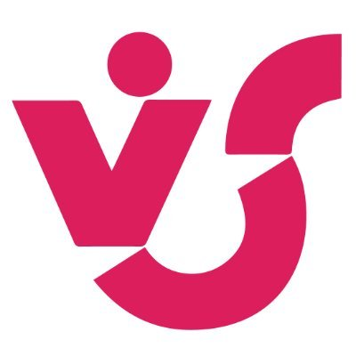



Technology Stack
Oil & Gas Software
Operating Systems Software
PLAXIS 2D
Rosemount
WinCC
AVEVA Engineering
Linux
Windows 10
Windows Server
Apple iOS
Payment Software
Procurement Software
American Express
SpendMap
SAP Ariba
SAP Fieldglass
SAP Supplier Relationship Management
Productivity & Collaboration Software
Product Lifecycle Management Software
Microsoft SharePoint
Microsoft Teams
Verizon (ACS)
WalkMe
Autodesk Vault
Teamcenter
Enovia
AVEVA E3D Design
Programming Language
Project Portfolio Management Software
Hyper Text Markup Language (HTML)
PowerShell
Python (Programming Language)
Visual Basic for Applications (VBA)
Portfolio Project Manager by Virto
Safran Planner
SAP PS
Oracle Primavera
Note: The tools listed above are not exhaustive.

Slide 32
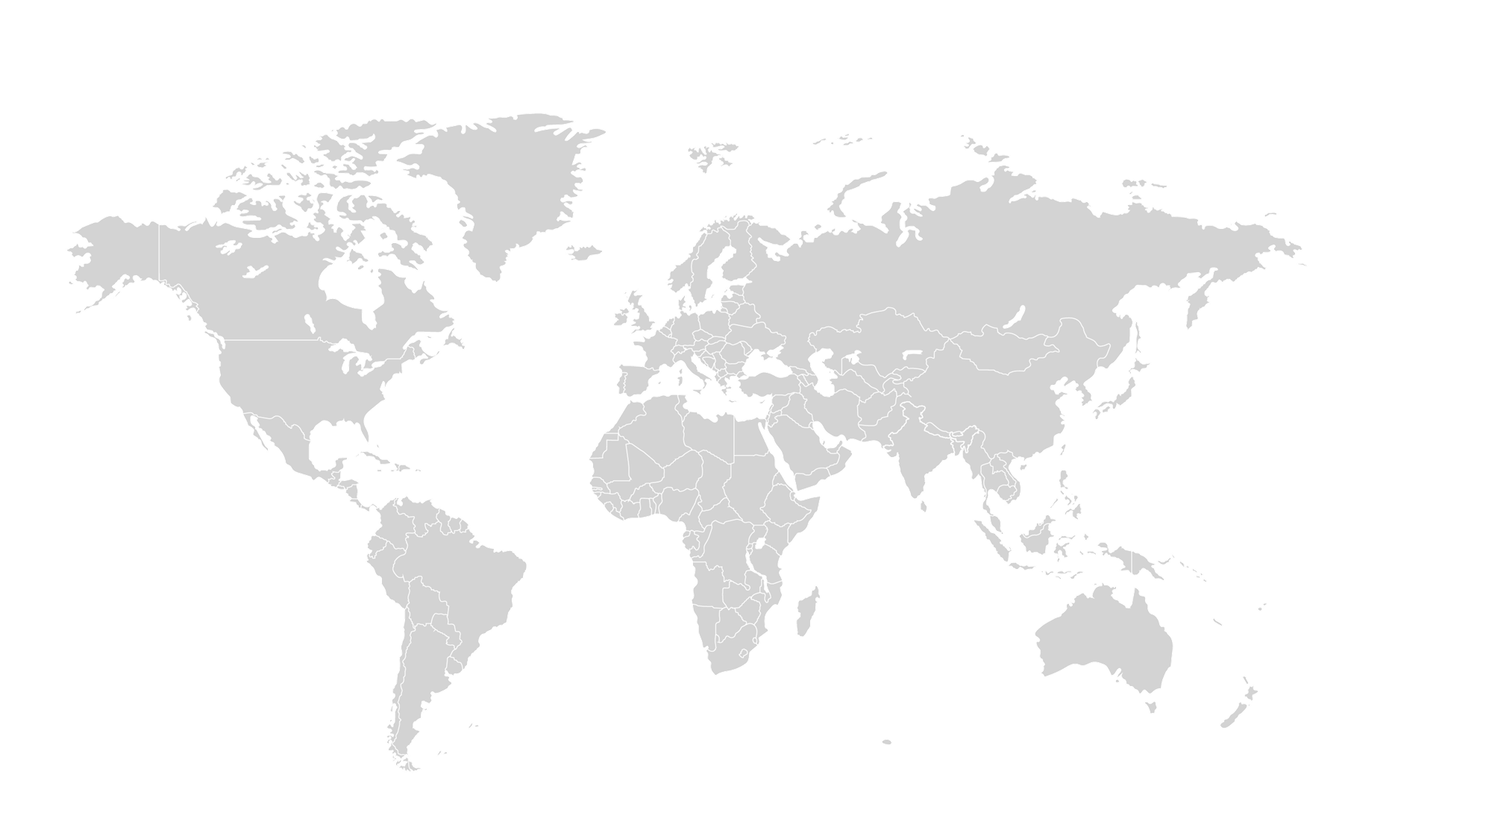
Global Footprint:
Legal
Global Legal Footprint for TechnipFMC PLC
14
Total Number of Locations
38
27
Key Locations
Total Workforce
Aberdeen, United Kingdom Paris Area, France Oslo, Norway Ostfold, Norway Buskerud, Norway
70
Focused Workloads for Top Locations
Americas
~54.3%
~28.6%
APAC
Aberdeen, United Kingdom • Contract Management & Transaction • Litigation Rio de Janeiro Area, Brazil • Contract Management & Transaction • Litigation
EMEA
~17.1%
6
20
7
12
Key Locations
Key Locations
Rio de Janeiro Area, Brazil Houston, Texas Area, United States Greater Los Angeles Area, United States Sao Paulo Area, Brazil St. John's Area, Canada
Singapore Federal Territory of Kuala Lumpur, Malaysia National Capital Region, India Selangor, Malaysia Shanghai, China
No. of Locations
Total Workforce
Regional Workforce Proportion
Note: Percentages may not sum to 100%, because of rounding. The above-mentioned focused workloads are not exhaustive.

Slide 33
Global Footprint:
Human Resources
Global Human Resources Footprint for TechnipFMC PLC
19
Total Number of Locations
60
40
Key Locations
Total Workforce
Aberdeen, United Kingdom Buskerud, Norway Paris Area, France Krakow, Poland Abu Dhabi, United Arab Emirates
155
Focused Workloads for Top Locations
Americas
~38.7%
~35.5%
APAC
Rio de Janeiro Area, Brazil • Talent Acquisition • Compensation & Benefits • Learning & Development • Hr Strategy & Governance • Employee Relation, Engagement & Retention Houston, Texas Area, United States • Workforce Administration & Management • Compensation & Benefits • Learning & Development • Talent Acquisition • Hr Strategy & Governance
EMEA
~25.8%
13
55
8
40
Key Locations
Key Locations
Houston, Texas Area, United States Rio de Janeiro Area, Brazil St. John's Area, Canada Calgary Area, Canada Rest of Alberta, Canada
National Capital Region, India Federal Territory of Kuala Lumpur, Malaysia Hyderabad Area, India Singapore Jakarta, Indonesia
No. of Locations
Total Workforce
Regional Workforce Proportion
Note: Percentages may not sum to 100%, because of rounding. The above-mentioned focused workloads are not exhaustive.

Slide 34
Global Footprint:
Customer Support & Service
Global Customer Support & Service Footprint for TechnipFMC PLC
45
Total Number of Locations
114
111
Key Locations
Total Workforce
Rogaland, Norway Aberdeen, United Kingdom Vestland, Norway Eastern, Saudi Arabia Luanda, Angola
255
Focused Workloads for Top Locations
Americas
~44.7%
~42.0%
APAC
Vestland, Norway • Customer Service & Support Rio de Janeiro Area, Brazil • Product Installation, Maintenance & Technical Support • Customer Service & Support
EMEA
~13.3%
48
107
18
34
Key Locations
Key Locations
Rio de Janeiro Area, Brazil Houston, Texas Area, United States Odessa-Midland, Texas Area, United States Tabasco Area, Mexico Erie-Meadville Area, United States
Jakarta, Indonesia Singapore Greater Perth Area, Australia Federal Territory of Kuala Lumpur, Malaysia Sabah, Malaysia
No. of Locations
Total Workforce
Regional Workforce Proportion
Note: Percentages may not sum to 100%, because of rounding. The above-mentioned focused workloads are not exhaustive.

Slide 35
Global Footprint:
R&D
Global R&D Footprint for TechnipFMC PLC
29
Total Number of Locations
7,800
49
Key Locations
Total Workforce
Aberdeen, United Kingdom Paris Area, France Abu Dhabi, United Arab Emirates Buskerud, Norway Oslo, Norway
17,120
Focused Workloads for Top Locations
Americas
~45.6%
~24.4%
APAC
Aberdeen, United Kingdom • Quality Assurance • Pipeline Engineering • Ui/Ux Design • Drill Engineering • Advanced Manufacturing, Automation & Control Systems Rio de Janeiro Area, Brazil • Quality Assurance • Drill Engineering • Manufacturing Engineering • Advanced Manufacturing, Automation & Control Systems • Application Development & Maintenance
EMEA
~30.0%
8
4,185
12
5,135
Key Locations
Key Locations
Rio de Janeiro Area, Brazil Houston, Texas Area, United States Greater Los Angeles Area, United States Capital District, Venezuela Sacramento, California Area, United States
Federal Territory of Kuala Lumpur, Malaysia Hyderabad Area, India Chennai Area, India National Capital Region, India Mumbai Area, India
No. of Locations
Total Workforce
Regional Workforce Proportion
Note: Percentages may not sum to 100%, because of rounding. The above-mentioned focused workloads are not exhaustive.

Slide 36
Global Footprint:
Finance & Accounting
Global Finance & Accounting Footprint for TechnipFMC PLC
30
Total Number of Locations
88
58
Key Locations
Total Workforce
Aberdeen, United Kingdom Abu Dhabi, United Arab Emirates Paris Area, France Edinburgh, United Kingdom Eastern, Saudi Arabia
190
Focused Workloads for Top Locations
Americas
~46.3%
~35.3%
APAC
Aberdeen, United Kingdom • General Accounting • Financial Planning & Analysis • Tax • Treasury & Risk Houston, Texas Area, United States • General Accounting • Financial Planning & Analysis • Tax • Internal Audit & Reporting • Accounts Payable
EMEA
~18.4%
18
67
10
35
Key Locations
Key Locations
Houston, Texas Area, United States Rio de Janeiro Area, Brazil Dallas-Fort Worth Area, United States Veracruz Area, Mexico Lake Charles-Jennings Area, United States
Federal Territory of Kuala Lumpur, Malaysia National Capital Region, India Singapore Jakarta, Indonesia Greater Perth Area, Australia
No. of Locations
Total Workforce
Regional Workforce Proportion
Note: Percentages may not sum to 100%, because of rounding. The above-mentioned focused workloads are not exhaustive.

Slide 37
Global Footprint:
Supply Chain
Global Supply Chain Footprint for TechnipFMC PLC
15
Total Number of Locations
59
40
Key Locations
Total Workforce
Rogaland, Norway Vestland, Norway Paris Area, France Rivers, Nigeria Edinburgh, United Kingdom
160
Focused Workloads for Top Locations
Americas
~36.9%
~45.0%
APAC
Rio de Janeiro Area, Brazil • Logistics & Distribution • Warehousing Houston, Texas Area, United States • Logistics & Distribution • Warehousing • Supply Chain Risk & Compliance • Inventory Management
EMEA
~18.1%
18
72
7
29
Key Locations
Key Locations
Houston, Texas Area, United States Rio de Janeiro Area, Brazil Veracruz Area, Mexico Demerara-Mahaica, Guyana Odessa-Midland, Texas Area, United States
Johore, Malaysia Singapore Federal Territory of Kuala Lumpur, Malaysia Kakinada Area, India Hyderabad Area, India
No. of Locations
Total Workforce
Regional Workforce Proportion
Note: Percentages may not sum to 100%, because of rounding. The above-mentioned focused workloads are not exhaustive.

Slide 38
Global Footprint:
Sales & Marketing
Global Sales & Marketing Footprint for TechnipFMC PLC
12
Total Number of Locations
90
28
Key Locations
Total Workforce
Aberdeen, United Kingdom Paris Area, France Abu Dhabi, United Arab Emirates Edinburgh, United Kingdom Buskerud, Norway
235
Focused Workloads for Top Locations
Americas
~38.3%
~48.5%
APAC
Rio de Janeiro Area, Brazil • Communication & Public Relation • Business Development • Account Management Houston, Texas Area, United States • Marketing Strategy & Brand Management • Sales Enablement & Support • Sales Strategy & Planning • Account Management • Digital Marketing
EMEA
~13.2%
10
114
6
31
Key Locations
Key Locations
Houston, Texas Area, United States Rio de Janeiro Area, Brazil Dallas-Fort Worth Area, United States Capital District, Colombia Greater Pittsburgh Area, United States
Federal Territory of Kuala Lumpur, Malaysia Jakarta, Indonesia National Capital Region, India Singapore Mumbai Area, India
No. of Locations
Total Workforce
Regional Workforce Proportion
Note: Percentages may not sum to 100%, because of rounding. The above-mentioned focused workloads are not exhaustive.

Slide 39
Global Footprint:
IT
Global IT Footprint for TechnipFMC PLC
15
Total Number of Locations
1,040
27
Key Locations
Total Workforce
Aberdeen, United Kingdom Buskerud, Norway Paris Area, France Abu Dhabi, United Arab Emirates Oslo, Norway
2,550
Focused Workloads for Top Locations
Americas
~40.8%
~43.7%
APAC
Rio de Janeiro Area, Brazil • Infrastructure Management System • Business Intelligence & Analytics • It Consulting • It Risk Management • Data Centre Management Houston, Texas Area, United States • Business Intelligence & Analytics • Infrastructure Management System • It Risk Management • It Consulting • Data Centre Management
EMEA
~15.5%
3
1,115
9
395
Key Locations
Key Locations
Rio de Janeiro Area, Brazil Houston, Texas Area, United States Sacramento, California Area, United States
Federal Territory of Kuala Lumpur, Malaysia Jakarta, Indonesia National Capital Region, India Johore, Malaysia Hyderabad Area, India
No. of Locations
Total Workforce
Regional Workforce Proportion
Note: Percentages may not sum to 100%, because of rounding. The above-mentioned focused workloads are not exhaustive.

Slide 40
Global Footprint:
Procurement
Global Procurement Footprint for TechnipFMC PLC
39
Total Number of Locations
126
73
Key Locations
Total Workforce
Paris Area, France Aberdeen, United Kingdom Krakow, Poland Rome Area, Italy Edinburgh, United Kingdom
260
Focused Workloads for Top Locations
Americas
~48.5%
~26.5%
APAC
Rio de Janeiro Area, Brazil • Strategic Sourcing & Purchasing • Vendor Management Houston, Texas Area, United States • Strategic Sourcing & Purchasing
EMEA
~25.0%
20
69
14
65
Key Locations
Key Locations
Rio de Janeiro Area, Brazil Houston, Texas Area, United States Dallas-Fort Worth Area, United States Veracruz Area, Mexico Sacramento, California Area, United States
Federal Territory of Kuala Lumpur, Malaysia Singapore Hyderabad Area, India Shanghai, China Johore, Malaysia
No. of Locations
Total Workforce
Regional Workforce Proportion
Note: Percentages may not sum to 100%, because of rounding. The above-mentioned focused workloads are not exhaustive.

Slide 41
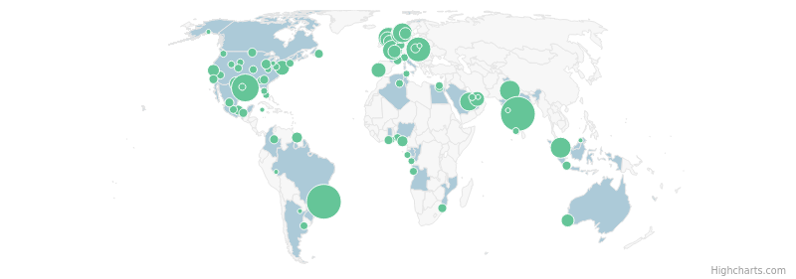
Hiring Analysis – Overall
4793
Job Postings (in last 12 Months)
95
Locations with Job Postings (in last 12 Months)
Top Locations | # of Job Postings
Rio de Janeiro Area, Brazil | 709
Hyderabad Area, India | 672
Houston, Texas Area, United States | 409
Krakow, Poland | 312
Johore, Malaysia | 198
National Capital Region, India | 197
Aberdeen, United Kingdom | 197
Seine-Maritime Area, France | 176
Buskerud, Norway | 159
Eastern, Saudi Arabia | 135
Job Postings Timeline
HIGH
MEDIUM
LOW
Recent Executive Movements
Top Business Functions
Top Workloads
Matthew F. Promoted as Director of People & Culture, East (Eastern Hemisphere), TechnipFMC PLC Jun. 2025
Willians Franklin Joined as Director of Accounting, TechnipFMC PLC May. 2025
Zak Mio Quit as Operations Manager, TechnipFMC PLC May. 2025
ER&D Customer Support & Service Management & Strategy Manufacturing & Production Sales & Marketing
Product Installation, Maintenance & Technical Support Project/Programs Management Quality Assurance Production Strategic Sourcing & Purchasing
Director of People & Culture, EMEA, TechnipFMC PLC
Controller, Supreme Electoral Tribunal of El Salvador
Director Of Operations, Stream-Flo Industries Ltd.
Get more insights
Note: The insights as mentioned above are based on job postings data for the last 12 months and are not exhaustive

Slide 42
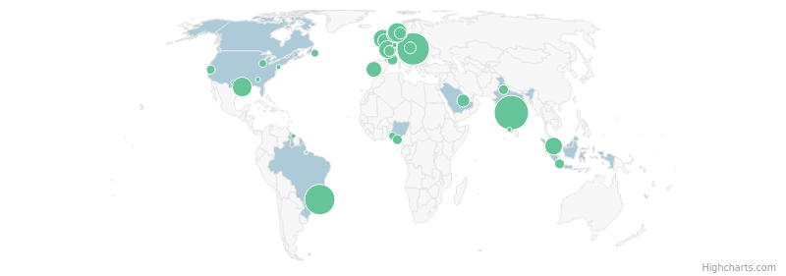
Hiring Analysis – ER&D
696
Job Postings (in last 12 Months)
37
Locations with Job Postings (in last 12 Months)
Top Locations | # of Job Postings
Hyderabad Area, India | 132
Krakow, Poland | 109
Rio de Janeiro Area, Brazil | 92
Houston, Texas Area, United States | 32
Buskerud, Norway | 31
Fife, United Kingdom | 28
Johore, Malaysia | 23
Aberdeen, United Kingdom | 23
Seine-Maritime Area, France | 22
Oslo, Norway | 19
Job Postings Timeline
HIGH
MEDIUM
LOW
Top Workloads
Job Titles in Demand
Core Skills in Demand
Quality Assurance Application Development & Maintenance Drill Engineering Project/Programs Management Advanced Manufacturing, Automation & Control Systems
Quality Engineer Design Engineer Supplier Quality Engineer Project Quality Engineer Manufacturing Engineer
Project Management Continuous Improvement Management Python (Programming Language) Atlassian Jira Product Design
Get more insights
Note: The insights as mentioned above are based on job postings data for the last 12 months and are not exhaustive

Slide 43
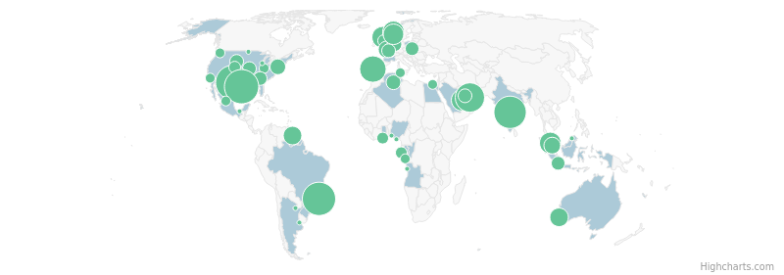
Hiring Analysis – Customer Support & Service
398
Job Postings (in last 12 Months)
53
Locations with Job Postings (in last 12 Months)
Top Locations | # of Job Postings
Houston, Texas Area, United States | 39
Odessa-Midland, Texas Area, United States | 38
Rio de Janeiro Area, Brazil | 36
Hyderabad Area, India | 33
Abu Dhabi, United Arab Emirates | 26
Lisbon, Portugal | 20
Vestland, Norway | 13
Federal Territory of Kuala Lumpur, Malaysia | 13
Aberdeen, United Kingdom | 13
Eastern, Saudi Arabia | 12
Job Postings Timeline
HIGH
MEDIUM
LOW
Top Workloads
Job Titles in Demand
Core Skills in Demand
Product Installation, Maintenance & Technical Support Plant Maintenance Customer Service & Support Project/Programs Management Property Management
Field Service Technician Customer Care Representative Field Service Technician Iv Field Service Technician I Workshop Service Technician Ii
Project Support Hydraulics Microsoft Office Service Management Field Service
Get more insights
Note: The insights as mentioned above are based on job postings data for the last 12 months and are not exhaustive

Slide 44
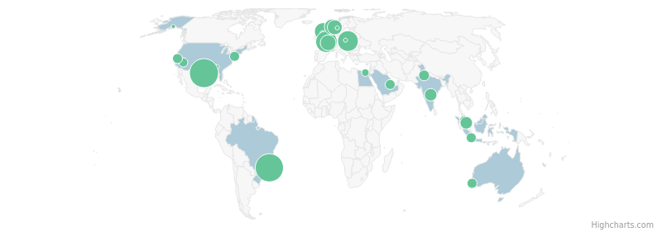
Hiring Analysis – Management & Strategy
300
Job Postings (in last 12 Months)
29
Locations with Job Postings (in last 12 Months)
Top Locations | # of Job Postings
Houston, Texas Area, United States | 58
Rio de Janeiro Area, Brazil | 54
Seine-Maritime Area, France | 27
Krakow, Poland | 24
Aberdeen, United Kingdom | 16
Vestland, Norway | 12
Paris Area, France | 12
Buskerud, Norway | 11
Johore, Malaysia | 7
Hyderabad Area, India | 7
Job Postings Timeline
HIGH
MEDIUM
LOW
Recent Executive Movements
Top Workloads
Job Titles in Demand
Core Skills in Demand
Lisa Bryant Promoted as Global Hr Shared Services Director, TechnipFMC PLC Apr. 2025
Peter Sharp Promoted as Director Of Projects & Country Manager, TechnipFMC PLC Mar. 2025
Project/Programs Management Corporate Strategy & Management Consulting Product Management Governance, Risk & Compliance Contract Management & Transaction
Project Engineer Senior Project Engineer Commercial Project Manager Project Manager Project Engineering Manager
Project Management Continuous Improvement Management Project Scheduling Microsoft Office Cost Control
Hr Director Subsea North America And Global Projects, TechnipFMC PLC
Director - Tendering & Estimating Apac, TechnipFMC PLC
Get more insights
Note: The insights as mentioned above are based on job postings data for the last 12 months and are not exhaustive

Slide 45
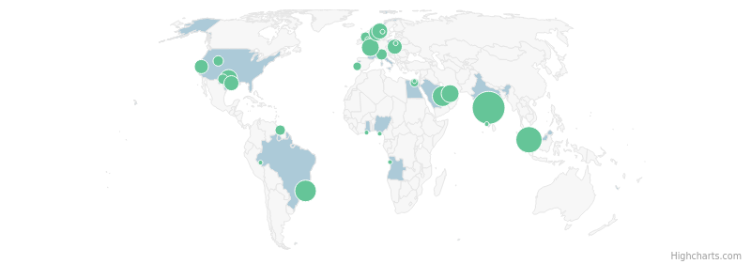
Hiring Analysis – Manufacturing & Production
278
Job Postings (in last 12 Months)
33
Locations with Job Postings (in last 12 Months)
Top Locations | # of Job Postings
Hyderabad Area, India | 64
Johore, Malaysia | 36
Rio de Janeiro Area, Brazil | 22
Eastern, Saudi Arabia | 21
Stephenville, Texas Area, United States | 14
Seine-Maritime Area, France | 14
Abu Dhabi, United Arab Emirates | 14
Rogaland, Norway | 10
Buskerud, Norway | 10
Krakow, Poland | 9
Job Postings Timeline
HIGH
MEDIUM
LOW
Top Workloads
Job Titles in Demand
Core Skills in Demand
Production Quality Control Production Planning Project/Programs Management Packaging
Production Planner Ii Senior Welding Engineer Assembly & Test Technician Assembler Iii Quality Inspector
Test Reporting Continuous Improvement Management Microsoft Office 5S Methodology Project Management
Get more insights
Note: The insights as mentioned above are based on job postings data for the last 12 months and are not exhaustive

Slide 46
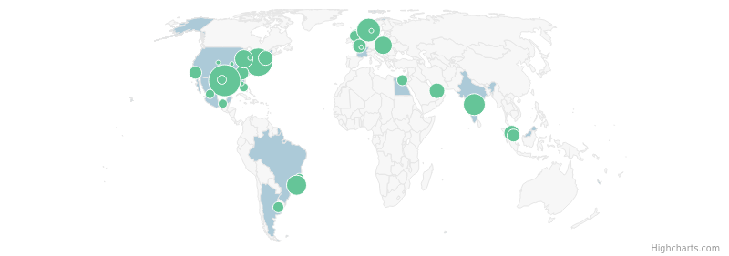
Hiring Analysis – Sales & Marketing
224
Job Postings (in last 12 Months)
37
Locations with Job Postings (in last 12 Months)
Top Locations | # of Job Postings
Houston, Texas Area, United States | 42
Greater Philadelphia Area, United States | 30
Buskerud, Norway | 20
Hyderabad Area, India | 17
Rio de Janeiro Area, Brazil | 13
Krakow, Poland | 11
Greater Chicago Area, United States | 10
Federal Territory of Kuala Lumpur, Malaysia | 7
Abu Dhabi, United Arab Emirates | 7
Greater Boston Area, United States | 6
Job Postings Timeline
HIGH
MEDIUM
LOW
Recent Executive Movements
Top Workloads
Job Titles in Demand
Core Skills in Demand
Lai Shu Hau Promoted as Director Commercial Surface East (Eastern Hemisphere), TechnipFMC PLC Apr. 2025
Marketing Strategy & Brand Management Product Management Sales Enablement & Support Quality Assurance Sales Strategy & Planning
Territory Manager, Dealer Sales Territory Manager Creative Director Product Engineer Territory Manager Development
Microsoft Office Continuous Improvement Management Automatic Computer-Aided Design (AutoCAD) Product Development Project Management
Regional Product Line Manager - Well Completion Systems - Asia and Pacific, TechnipFMC PLC
Get more insights
Note: The insights as mentioned above are based on job postings data for the last 12 months and are not exhaustive

Slide 47
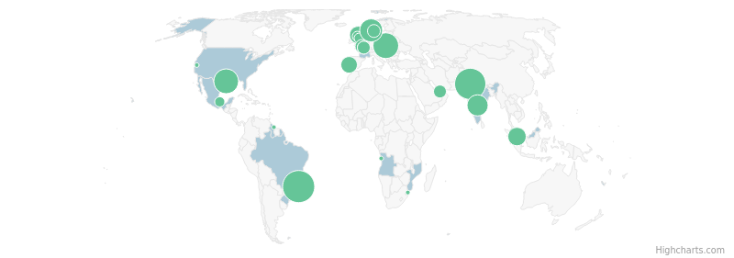
Hiring Analysis – Procurement
184
Job Postings (in last 12 Months)
26
Locations with Job Postings (in last 12 Months)
Top Locations | # of Job Postings
Rio de Janeiro Area, Brazil | 29
National Capital Region, India | 27
Krakow, Poland | 17
Houston, Texas Area, United States | 15
Buskerud, Norway | 13
Hyderabad Area, India | 11
Johore, Malaysia | 8
Aberdeen, United Kingdom | 7
Lisbon, Portugal | 6
Rogaland, Norway | 5
Job Postings Timeline
HIGH
MEDIUM
LOW
Top Workloads
Job Titles in Demand
Core Skills in Demand
Strategic Sourcing & Purchasing Project/Programs Management Corporate Strategy & Management Consulting Environment, Health & Safety
Buyer Senior Buyer Senior Executive-Procurement Buyer Ii Buyer Iii
Procurement Strategy Supply Chain Management (SCM) Supplier Management Microsoft Office Invoice Processing
Get more insights
Note: The insights as mentioned above are based on job postings data for the last 12 months and are not exhaustive

Slide 48
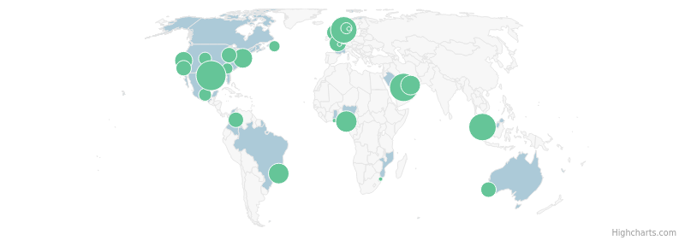
Hiring Analysis – Supply Chain
171
Job Postings (in last 12 Months)
32
Locations with Job Postings (in last 12 Months)
Top Locations | # of Job Postings
Houston, Texas Area, United States | 19
Eastern, Saudi Arabia | 16
Johore, Malaysia | 15
Rogaland, Norway | 14
Rivers, Nigeria | 9
Rio de Janeiro Area, Brazil | 8
Greater Philadelphia Area, United States | 7
Abu Dhabi, United Arab Emirates | 7
Sacramento, California Area, United States | 6
Seine-Maritime Area, France | 5
Job Postings Timeline
HIGH
MEDIUM
LOW
Top Workloads
Job Titles in Demand
Core Skills in Demand
Warehousing Logistics & Distribution Supply Chain Risk & Compliance Supply Chain Analytics Inventory Management
Warehouse Technician Warehouse Representative Warehouse Coordinator Logistics Coordinator Logistics/Warehouse Technician
Warehousing Housekeeping Microsoft Office Inventory Control Stocking
Get more insights
Note: The insights as mentioned above are based on job postings data for the last 12 months and are not exhaustive

Slide 49
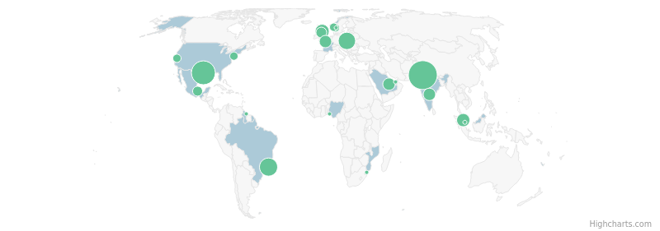
Hiring Analysis – Human Resources
152
Job Postings (in last 12 Months)
22
Locations with Job Postings (in last 12 Months)
Top Locations | # of Job Postings
National Capital Region, India | 45
Houston, Texas Area, United States | 28
Rio de Janeiro Area, Brazil | 15
Krakow, Poland | 13
Aberdeen, United Kingdom | 7
Federal Territory of Kuala Lumpur, Malaysia | 6
Seine-Maritime Area, France | 5
Hyderabad Area, India | 5
Eastern, Saudi Arabia | 5
Fife, United Kingdom | 4
Job Postings Timeline
HIGH
MEDIUM
LOW
Top Workloads
Job Titles in Demand
Core Skills in Demand
Workforce Administration & Management Talent Acquisition Learning & Development Compensation & Benefits HRIS & Analytics
Principle Consultant- Hr Information System Recruiter Deputy Manager - Hris Hr Business Partner Hr Generalists
Human Resources Information Systems (HRIS) Project Management Microsoft Office Payroll Software Shared Services
Get more insights
Note: The insights as mentioned above are based on job postings data for the last 12 months and are not exhaustive

Slide 50
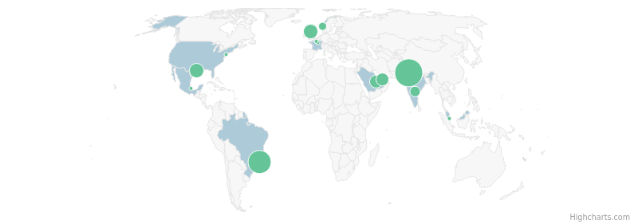
Hiring Analysis – Finance & Accounting
135
Job Postings (in last 12 Months)
15
Locations with Job Postings (in last 12 Months)
Top Locations | # of Job Postings
National Capital Region, India | 49
Rio de Janeiro Area, Brazil | 30
Houston, Texas Area, United States | 9
Fife, United Kingdom | 9
Eastern, Saudi Arabia | 7
Abu Dhabi, United Arab Emirates | 7
Aberdeen, United Kingdom | 7
Hyderabad Area, India | 4
Buskerud, Norway | 2
Yonne Area, France | 1
Job Postings Timeline
HIGH
MEDIUM
LOW
Top Workloads
Job Titles in Demand
Core Skills in Demand
Financial Planning & Analysis General Accounting Accounts Payable Internal Audit & Reporting Governance, Risk & Compliance
Project Cost Manager Lead Analyst-F&A Gl Finance Lead - Aftermarket General Accounting Analyst Internal Audit And Controls Senior Manager
Internal Controls Auditing Balance Sheet Analysis Microsoft Office Financial Reporting
Get more insights
Note: The insights as mentioned above are based on job postings data for the last 12 months and are not exhaustive

Slide 51
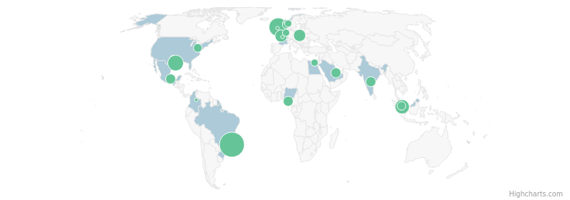
Hiring Analysis – Administrative Operations
133
Job Postings (in last 12 Months)
22
Locations with Job Postings (in last 12 Months)
Top Locations | # of Job Postings
Rio de Janeiro Area, Brazil | 38
Aberdeen, United Kingdom | 18
Houston, Texas Area, United States | 12
Singapore | 10
Seine-Maritime Area, France | 6
Krakow, Poland | 6
Veracruz Area, Mexico | 4
Rivers, Nigeria | 4
Hyderabad Area, India | 4
Eastern, Saudi Arabia | 4
Job Postings Timeline
HIGH
MEDIUM
LOW
Top Workloads
Job Titles in Demand
Core Skills in Demand
Environment, Health & Safety Asset Maintenance & Engineering Admin & Support Project/Programs Management Governance, Risk & Compliance
Tec Hse Offshore Iii Executive Assistant Administrative Assistant Hse Manager Tec Hse Iii
Microsoft Office HSE Management Systems Power BI Incident Investigation Case Management
Get more insights
Note: The insights as mentioned above are based on job postings data for the last 12 months and are not exhaustive

Slide 52
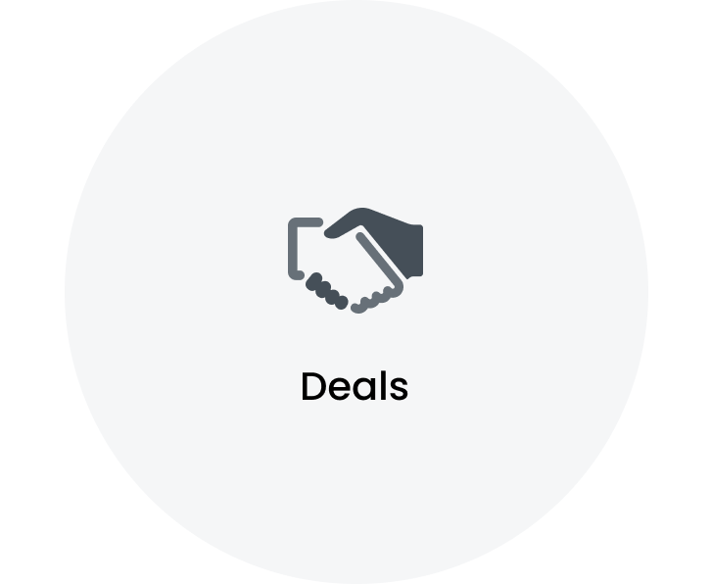
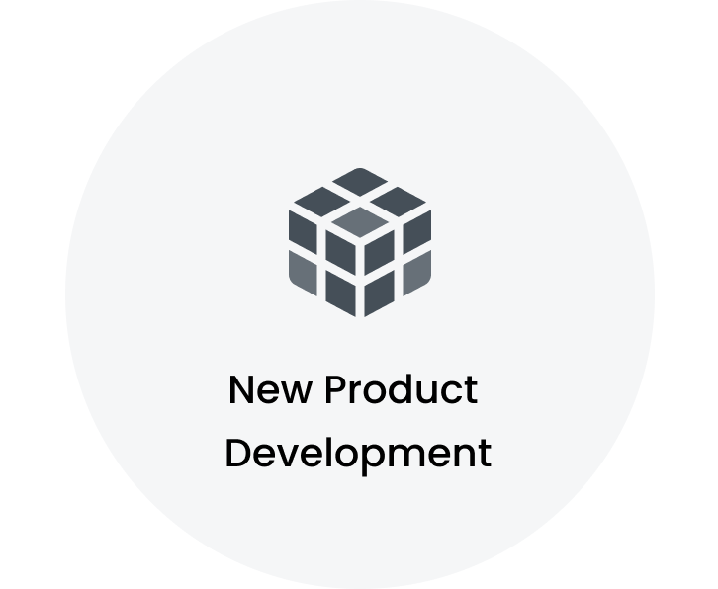
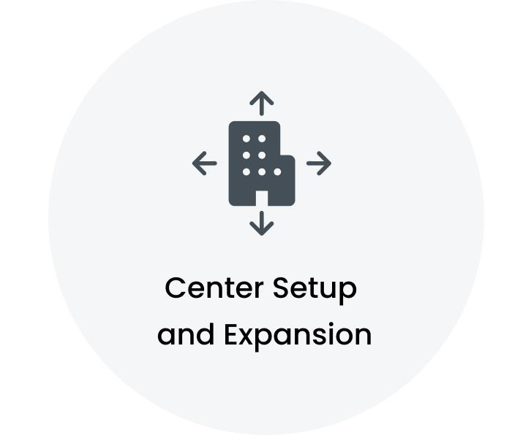
Key Signals
TotalEnergies ENEOS completes rooftop solar power plant with TechnipFMC in Malaysia TotalEnergies ENEOS completes rooftop solar project with TechnipFMC in Malaysia TechnipFMC bags work on Equinors North Sea project TechnipFMC wins significant contract for Equinor's Heidrun extension
Brazils Petrobras and TechnipFMC trial new electric subsea technology
TechnipFMC begins operations at GMR AeroCity Hyderabads SEZ park
Note: The signals mentioned above are not exhaustive.

Slide 53
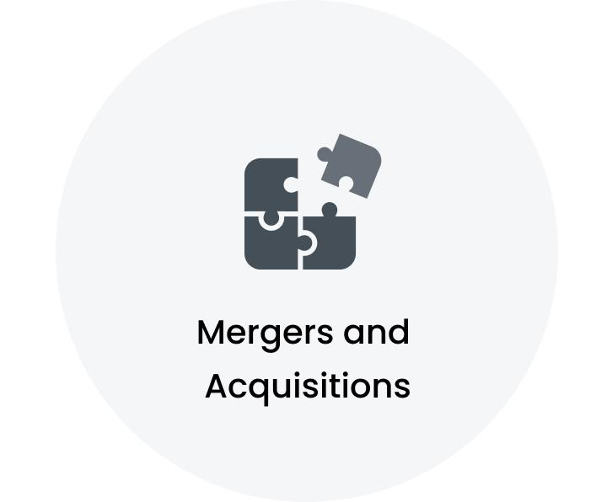
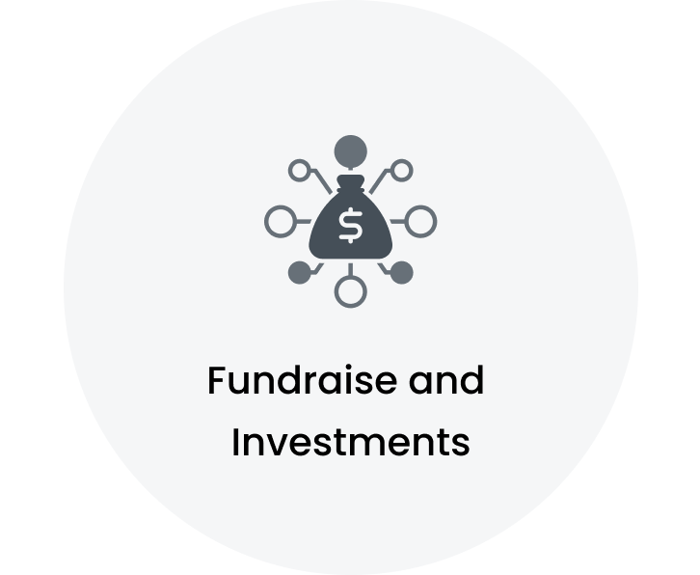
Key Signals
TechnipFMC plc : Redefining oil extraction -February 10, 2025 at 04:07 pm EST
Interval Partners LP Makes New $4.27 Million Investment in TechnipFMC plc (NYSE:FTI) Acadian Asset Management LLC Invests $4.06 Million in TechnipFMC plc (NYSE:FTI) ORG Partners LLC Invests $33,000 in TechnipFMC plc (NYSE:FTI)
Note: The signals mentioned above are not exhaustive.

Slide 54


Outsourcing Overview: Plant Maintenance is the highly outsourced segment
Active Outsourcing Partners
~
33
Total Workforce analyzed
~
770
Highlights
Workflows split by Micro verticals
Key Service Providers are Adecco Group AG | Capgemini | Cognizant Top Outsourced Workloads are Plant Maintenance | Project/Programs Management | Product Installation, Maintenance & Technical Support Top Service Partner Locations are Seine-Maritime Area, France | Hyderabad Area, India | Bengaluru Area, India

Slide 55

Vendor Analysis: A Comprehensive List of Top 15 Companies
Adecco Group AG, Capgemini, Cognizant are the key service providers for TechnipFMC PLC
Top 15 service providers cover 77% of the total outsourcing workflows
Key Provider Locations:
Seine-Maritime Area, France Hyderabad Area, India Bengaluru Area, India Rio de Janeiro Area, Brazil Paris Area, France

Slide 56




Top 5 Service Providers:
Adecco Group AG is the key strategic partner for TechnipFMC PLC
Key Provider | Key Provider MSA | Workflows split by Micro Vertical
Seine-Maritime Area, France Paris Area, France
Hyderabad Area, India Bengaluru Area, India Mumbai Area, India
Hyderabad Area, India Bengaluru Area, India Chennai Area, India
GI GROUP HOLDING S.p.A.
Rio de Janeiro Area, Brazil Minas Gerais Area, Brazil
Bengaluru Area, India

Slide 57
Functional Workload Deep Dive (1/20): Plant Maintenance
Total Outsourcing Partners
Total Workflows Analyzed
Service Providers | Key Workflow
 | • Maintenance System Coordinator responsibilities • Triggering and monitoring equipment cycle stages in management system • Updating compliance indicators and pending loads
~ 1
~ 14
Share by Service Providers
Key Provider Location
Seine-Maritime Area, France
Note: Service Provider share is based on the number of projects.

Slide 58
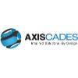


Functional Workload Deep Dive (2/20): Project/Programs Management
Total Outsourcing Partners
Total Workflows Analyzed
Service Providers | Key Workflow
 | • Managing production of required deliverables • Planning and monitoring projects • Programming application according to functional requirements
Arabian International Contracting Co. WLL. | • Planning and coordination of steel structures erection • Management of piping works • Oversight of project timelines and milestones
 | • Engineering schedules management • Timely updates communication to project and engineering management • Root Cause Analyses facilitation for issue identification
 | • EPC package execution of 126m high RCC prilling tower • Miscellaneous civil work execution for urea unit • Collaboration with Technip FMC for project delivery
 | • Leading a team of engineers • Preparation of WBR, MBR, and QBR presentations • Improvement of KPIs and metrics
~ 6
~ 7
Share by Service Providers
Key Provider Locations
Attica, Greece
Bengaluru Area, India
Bokaro Area, India
Capital Governorate, Bahrain
Hyderabad Area, India
Note: Service Provider share is based on the number of projects.

Slide 59
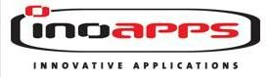
Functional Workload Deep Dive (3/20): Product Installation, Maintenance & Technical Support
Total Outsourcing Partners
Total Workflows Analyzed
Service Providers | Key Workflow
 | • Preparation and reintegration of tools and equipment for Assembly and Distribution Unit activities • Preventive and curative maintenance of equipment and installations for Assembly and Distri...
 | • Azure Data Engineer Jr - management, optimization, supervision, and monitoring of data retrieval, storage, and distribution • development of algorithms for transforming raw data into useful i...
 | • Technip HARP Portal project • SOX portal • Different applications reviewers
 | • Senior Oracle SCM Functional Consultant • Management of supply chain processes • Configuration of Oracle SCM modules
~ 4
~ 6
Share by Service Providers
Key Provider Locations
Seine-Maritime Area, France
Bengaluru Area, India
Espirito Santo Area, Brazil
Federal Territory of Kuala Lumpur, Malaysia
Mumbai Area, India
Note: Service Provider share is based on the number of projects.

Slide 60


Functional Workload Deep Dive (4/20): Business Intelligence & Analytics
Total Outsourcing Partners
Total Workflows Analyzed
Service Providers | Key Workflow
 | • SSAS/PBI Developer role • June 2020- Till Date duration • Power BI, Visual Studio, SSMS, SQL Developer environment
 | • Highly impactful dashboards • Contingent and services metrics for SLAs, KPIs, cost savings, headcount, spend, and supplier scorecards • Scheduled and ad hoc report development in various tools...
 | • Understanding and analyzing client data for business requirements • Writing SQL queries for data extraction from the database • Extracting, transforming, and loading data for dashboard creatio...
 | • Importing data from SharePoint and Power BI semantic model • Implementing row-level security on data and understanding application security layer models in Power BI • Creating DAX queries to g...
~ 4
~ 5
Share by Service Providers
Key Provider Locations
Hyderabad Area, India
Greater Detroit Area, United States
Note: Service Provider share is based on the number of projects.

Slide 61
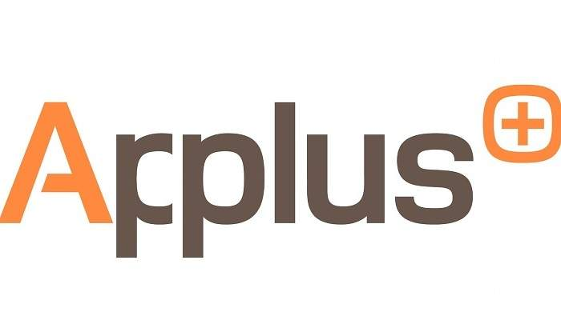



Functional Workload Deep Dive (5/20): Quality Control
Total Outsourcing Partners
Total Workflows Analyzed
Service Providers | Key Workflow
 | • - N2 Welding Inspector - Quality Supervisor - Manufacture of Jumpers, Risers, and FlowLines - Mero 2 Project - TechnipFMC Spoolbase - Porto do AASSu Rj - Standards: DNVOSF1012017, API 1104 E...
 | • Subsea 7 Julimar Phase 2 Connector Project ICB Fabrication Surveillance • Onesubsea Trident Ceiba TPIA Project ICB Fabrication Surveillance • Onesubsea Interco PROTLETHEN Anausuria Project ICB...
 | • Manifold equipment for submerged oil and gas extraction • Quality control and monitoring of assembly and maintenance teams • Hydrostatic and functional testing responsibilities
GI GROUP HOLDING S.p.A. | • Roles in project management • Responsibilities in engineering design • Coordination of project activities
 | • Product Engineer responsibilities • Qualification Team duties • Development of test procedures for seals
~ 5
~ 5
Share by Service Providers
Key Provider Locations
Minas Gerais Area, Brazil
Hyderabad Area, India
Rio de Janeiro Area, Brazil
Singapore
Note: Service Provider share is based on the number of projects.

Slide 62
Functional Workload Deep Dive (6/20): Application Development & Maintenance
Total Outsourcing Partners
Total Workflows Analyzed
Service Providers | Key Workflow
 | • End-to-end HAM project implementation activities • Client asset tool migration to Service Now platform • Coordination of project timelines and deliverables
 | • User creation and role assignment • Custom role creation and authorization management in SAP • Modification of existing roles based on change requests
Disys | • Back-End development using Python Node.js and .NET Core 3.1 • Building RESTful APIs as a primary focus • Configuration of Azure repositories and implementation of pipelines for CI/CD
~ 3
~ 4
Share by Service Providers
Key Provider Locations
Hyderabad Area, India
Sao Paulo Area, Brazil
Note: Service Provider share is based on the number of projects.

Slide 63


Functional Workload Deep Dive (7/20): Software Testing
Total Outsourcing Partners
Total Workflows Analyzed
Service Providers | Key Workflow
 | • Understanding functionality • Utilizing UFT Framework Automation Scripts based on client expectations • Executing all scripts, fixing failed scripts, and continuing execution
 | • Technical Testing and Expertise Agent responsibilities • Conducting tests and manufacturing prototypes within established procedures • Participating in test execution and prototype manufacturi...
 | • Functional study of the application • Running jobs and workflows for ETL process • Preparation of SQL queries for data verification
~ 3
~ 4
Share by Service Providers
Key Provider Locations
Bengaluru Area, India
Hyderabad Area, India
Seine-Maritime Area, France
Srikakulam Area, India
Note: Service Provider share is based on the number of projects.

Slide 64
Functional Workload Deep Dive (8/20): Data Engineering
Total Outsourcing Partners
Total Workflows Analyzed
Service Providers | Key Workflow
 | • Advanced ETL workflows using SSIS, SQL Stored Procedures, and C# scripting for report generation and cube refresh operations • Intricate SSIS packages with enhanced control flow mechanisms, r...
~ 1
~ 3
Share by Service Providers
Key Provider Locations
Bengaluru Area, India
Hyderabad Area, India
Mumbai Area, India
Note: Service Provider share is based on the number of projects.

Slide 65
Functional Workload Deep Dive (9/20): Packaging
Total Outsourcing Partners
Total Workflows Analyzed
Service Providers | Key Workflow
 | • Coil movements packing and assembly of peripheral equipment • Implementation of procedures working documents and self-control procedures • Coverage of pipes leaving the manufacturing process
~ 1
~ 3
Share by Service Providers
Key Provider Location
Seine-Maritime Area, France
Note: Service Provider share is based on the number of projects.

Slide 66
Functional Workload Deep Dive (10/20): Customer Service & Support
Total Outsourcing Partners
Total Workflows Analyzed
Service Providers | Key Workflow
 | • Documentation creation and maintenance for system configuration, mapping, processes, printers, software, and service records • Ticket closure and SOP development • Orientation and training for...
~ 1
~ 2
Share by Service Providers
Key Provider Locations
Bengaluru Area, India
Chennai Area, India
Note: Service Provider share is based on the number of projects.

Slide 67

Functional Workload Deep Dive (11/20): Mobile Application Development
Total Outsourcing Partners
Total Workflows Analyzed
Service Providers | Key Workflow
 | • Senior Consultant • Android platform applications • Android, Kotlin, MVVM, Jetpack Component, Modular, Clean Architecture, Mockk
 | • Mobile First project • Updated environments to Sitecore 9.2 and Visual Studio 2019 • Front end technology including Bootstrap 4+ and jQuery 3+
~ 2
~ 2
Share by Service Providers
Key Provider Locations
Pune Area, India
West Yorkshire, United Kingdom
Note: Service Provider share is based on the number of projects.

Slide 68
Functional Workload Deep Dive (12/20): Production
Total Outsourcing Partners
Total Workflows Analyzed
Service Providers | Key Workflow
 | • Manufacture of products on assigned machines in accordance with performance quality and safety objectives • Implementation of manufacturing repair and self-checking procedures including opera...
~ 1
~ 2
Share by Service Providers
Key Provider Location
Seine-Maritime Area, France
Note: Service Provider share is based on the number of projects.

Slide 69


Functional Workload Deep Dive (13/20): System Integration
Total Outsourcing Partners
Total Workflows Analyzed
Service Providers | Key Workflow
 | • Incidents from Payables EBS application • Releases from Services Purchase Orders and Complex Purchase Orders • Customizations of Projects module
 | • Proposing alternative or standard solutions where applicable • Conducting workshops during sprints to demonstrate solutions to subject matter experts and identify gaps • Engaging in green fiel...
~ 2
~ 2
Share by Service Providers
Key Provider Locations
Hyderabad Area, India
Sao Paulo Area, Brazil
Note: Service Provider share is based on the number of projects.

Slide 70
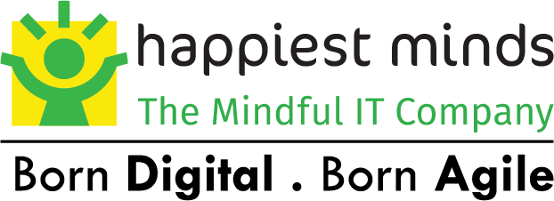
Functional Workload Deep Dive (14/20): Talent Acquisition
Total Outsourcing Partners
Total Workflows Analyzed
Service Providers | Key Workflow
 | • Recruitment firm specializing in temporary work • Transition management and evaluation of experts, executives, and managers • Guidance through career development
 | • End-to-end recruitment responsibility • Interaction with sales team, account manager, client management, delivery team, business controls team, and finance team • Experience in senior and mid-...
~ 2
~ 2
Share by Service Providers
Key Provider Locations
Bengaluru Area, India
Paris Area, France
Note: Service Provider share is based on the number of projects.

Slide 71
Functional Workload Deep Dive (15/20): UI/UX Design
Total Outsourcing Partners
Total Workflows Analyzed
Service Providers | Key Workflow
 | • Design-led culture • mentoring and guidance in design methodologies • real-time project management practices
~ 1
~ 2
Share by Service Providers
Key Provider Location
Bengaluru Area, India
Note: Service Provider share is based on the number of projects.

Slide 72

Functional Workload Deep Dive (16/20): Account Management
Total Outsourcing Partners
Total Workflows Analyzed
Service Providers | Key Workflow
 | • Sales team leadership for Large Enterprise and Global Accounts • Oversight of FSI, Utilities, Professional Services, Telco, and Construction sectors • Client management for major organizations...
~ 1
~ 1
Share by Service Providers
Key Provider Location
Paris Area, France
Note: Service Provider share is based on the number of projects.

Slide 73

Functional Workload Deep Dive (17/20): Bio-Energy Systems & Technology
Total Outsourcing Partners
Total Workflows Analyzed
Service Providers | Key Workflow
 | • Detailed engineering works for technological structures • Propylene recovery unit dimensions of 18m x 25m x 44m • Propylene recovery unit dimensions of 26.5m x 38.5m x 27m
~ 1
~ 1
Share by Service Providers
Key Provider Location
Mumbai Area, India
Note: Service Provider share is based on the number of projects.

Slide 74

Functional Workload Deep Dive (18/20): Business Development
Total Outsourcing Partners
Total Workflows Analyzed
Service Providers | Key Workflow
 | • Profitability of Technical Assistance activity in Greater West and IDF • Team management of around fifteen consultants • Client support for large EPC projects
~ 1
~ 1
Share by Service Providers
Key Provider Location
Paris Area, France
Note: Service Provider share is based on the number of projects.

Slide 75
Functional Workload Deep Dive (19/20): Demand Management
Total Outsourcing Partners
Total Workflows Analyzed
Service Providers | Key Workflow
 | • Sheet metal and assembly drawings for oil and gas equipment • Client interactions for project requirement understanding • Project planning with the Project Manager for successful delivery
~ 1
~ 1
Share by Service Providers
Key Provider Location
Ananthapuramu Area, India
Note: Service Provider share is based on the number of projects.

Slide 76

Functional Workload Deep Dive (20/20): Governance, Risk & Compliance
Total Outsourcing Partners
Total Workflows Analyzed
Service Providers | Key Workflow
 | • FERA EERA QRA and Qualitative Assessment for Fire and Gas Mapping • Stage II and III Building Risk Assessment assistance • HAZOP Risil Mat Handling report preparation
~ 1
~ 1
Share by Service Providers
Key Provider Location
Federal Territory of Kuala Lumpur, Malaysia
Note: Service Provider share is based on the number of projects.

Slide 77
Key Executives
Douglas Pferdehirt Chairman and Chief Executive Officer Greater London, United Kingdom
Doug Pferdehirt Chief Executive Officer Houston, Texas Area, United States
Justin Rounce Executive Vice President & Chief Technology Officer Houston, Texas Area, United States
Anju Menon APillai Executive Secretary- COO Abu Dhabi, United Arab Emirates
christophe chevrier Chief Operation Officer Doha, Qatar
Alf Melin Executive Vice President & Chief Financial Officer Houston, Texas Area, United States
Tushar Mudgal Chief Executive Officer Dubai, United Arab Emirates
Dafna Mashiach CfO Northern, Israel
Cristina Aalders Executive Vice President, Chief Legal Officer And Secretary Houston, Texas Area, United States
Kolawole Akinsebikan ,FCCA,MBA Finance Director, Business Unit Chief Financial Officer Houston, Texas Area, United States
Roberto Jourdan de Aquino COO Flexible Division - Technip Brasil Rio de Janeiro Area, Brazil
David Light SVP and Chief Accounting Officer Houston, Texas Area, United States
Note: Executives mentioned above are some of the key executives in the organization and not exhaustive.

Slide 78
Key Executives
Dag Almar Hansen Ceo Vestfold, Norway
Bjørnar Simonsen Chief Operating Officer Vestfold, Norway
Thomo Moraka Deputy Chief Executive Officer Johannesburg, Gauteng, South Africa
Valeria Santos Iannone Executive Vice President & Chief People Officer Houston, Texas Area, United States
LYES zekraoui Cfa/cfo Engineer Technip France Algiers, Algeria
Ahmad ElSherbini Co-founder And Ceo Suez, Egypt
Christopher Ward VP, Chief Information Security Officer Houston, Texas Area, United States
R Balaji Chief Financial Officer Chennai Area, India
Graham Crisp Senior Vice President & Chief Information Officer Houston, Texas Area, United States
Raghavendra TR Ceo Bengaluru Area, India
Jayasankaran R COO Chennai Area, India
Victoria Lazar Executive Vice President, Chief Legal Officer and Secretary Houston, Texas Area, United States
Note: Executives mentioned above are some of the key executives in the organization and not exhaustive.

Slide 79
Key Executives
Federico Calvo President Miami-Fort Lauderdale Area, United States
Rune Thoresen President Europe Subsea Projects Akershus, Norway
Shekhar Balvalli Senior Vice President-Country Management-Onshore Business National Capital Region, India
R S Kumar Svp,india Subsea Head Mumbai Area, India
Luana Duffé Executive Vice President New Energy Rio de Janeiro Area, Brazil
Nikhil Shahane VP, Global Head of People Development Houston, Texas Area, United States
Alfredo Sanchez Mogollon Senior Vice President - Surface Western Hemisphere Houston, Texas Area, United States
Jose Renato Marins Senior Vice President Rio de Janeiro Area, Brazil
Anders Dahl Senior Vice President Buskerud, Norway
Horn Graham Senior Vice President - Surface International Singapore
Christophe Dieumegard Senior Vice President Subsea Commercial Houston, Texas Area, United States
Thierry Conti President - Surface Abu Dhabi, United Arab Emirates
Note: Executives mentioned above are some of the key executives in the organization and not exhaustive.

